Slide 1
University of Wollongong in Dubai
ENGG105 AUTOCAD LAB 1

Slide 2
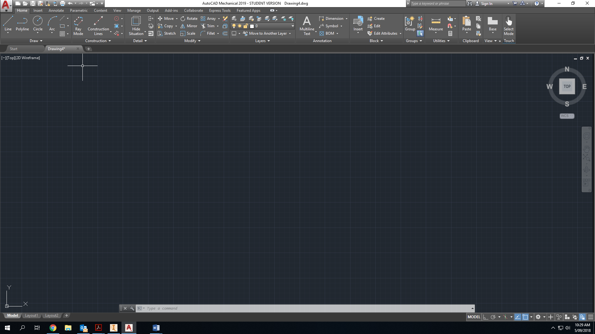
Main screen
InfoCenter
Tool Panel
UCS icon
Command bar
Status bar

Slide 3
Main screen
The command bar shows the procedure of completing any chosen command by showing the needed steps. “watch it all the time”
The InfoCenter enables you to access product-related information sources by searching in the Help system.
UCS icon stands for “User Coordinate System” which defines the reference point and the x and y axes. You can select, move, and rotate the UCS icon to change the current UCS.

Slide 4
Status bar
The status bar is displayed at the bottom of the screen. It contains buttons that makes it easy to change the status of some AutoCad drawings.
Ortho mode
Object snap tracking
Customization
Polar Tracking
Osnap mode
Isometric drafting

Slide 5
Status bar
Snap Tracking
The Snap Mode is active when the snap mode button is pressed in the status bar. This allows you to move the curser in fixed increments.
Polar Tracking (or Polar Snap)
It restricts the cursor movement to some specified angles. Choose the desired angle increments from the arrow besides it
Osnap
It provides the capability of snapping specific points on your drawings such as midpoints, endpoints, geometric centers, etc…
Ortho Mode
This mode allows you to draw lines at right angles (90deg angles) only.

Slide 6
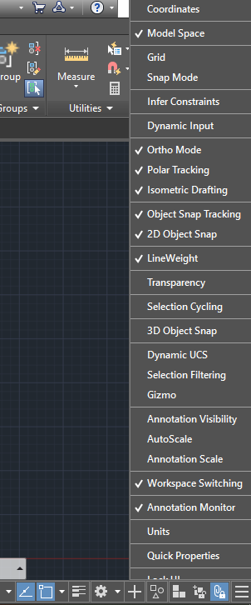
Status bar
Customization
It shows different options to be added to the status bar.
Grid
Grid lines are the lines shown in the main drawing screen. They are used as reference lines in drawing.
LineWeight
It allows you to increase the line thickness of the drawing in order to make it more visible and clear.
Dynamic Input
It displays an input text in space in order to type the command needed (such as line, circle, etc..)0

Slide 7

Modify Tool Bar
Mirror
Rotate
Array
Erase
Move
Trim
Power copy
Explode
Offset
Stretch
Scale
Fillet

Slide 8
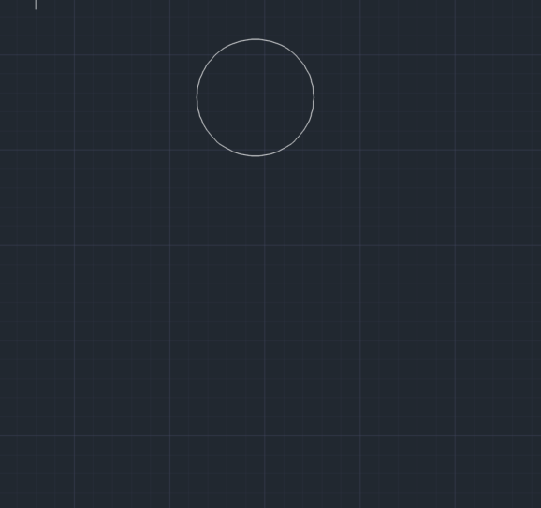
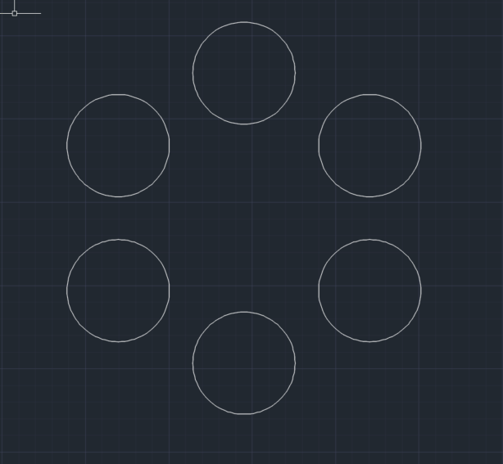
Modify Tool Bar
Array
You can create multiple copies in linear and circular manner.

Slide 9
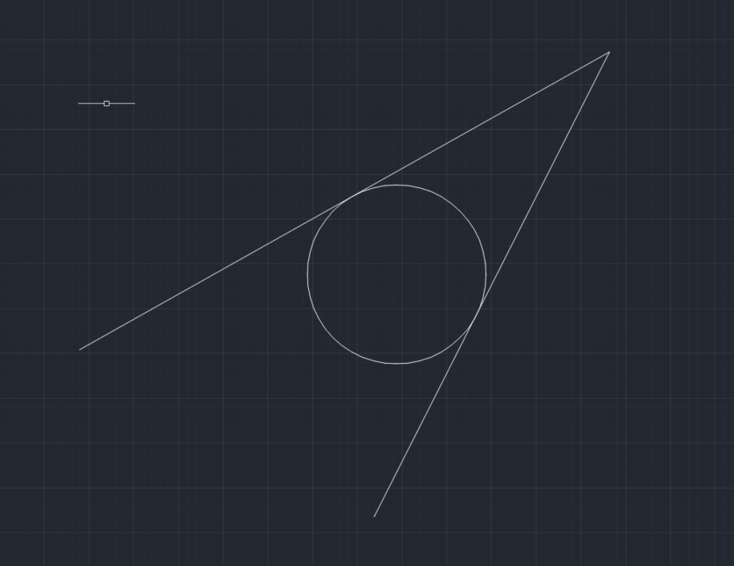
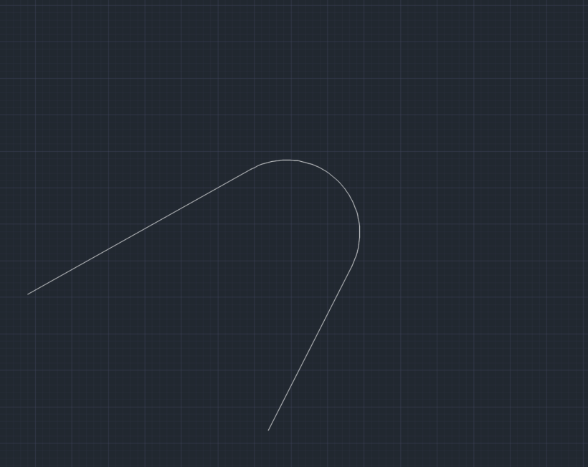
Modify Tool Bar
Trim
Trim is used to remove the unwanted edges beyond a required point of intersection.

Slide 10
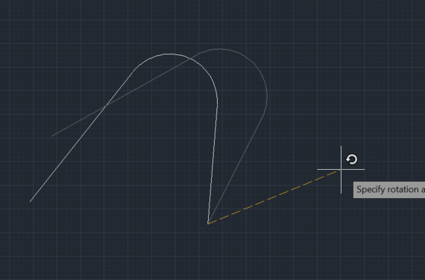
Modify Tool Bar
Rotate
Used to rotate an objects a certain angle about a specified base point.

Slide 11
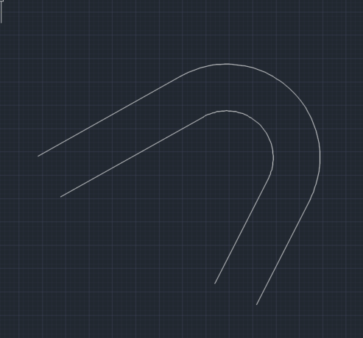
Modify Tool Bar
Offset
Used to draw similar objects parallel to the original object with a specified distance.

Slide 12
Coordinate Systems
Absolute Rectangular coordinate
The absolute rectangular coordinate system divides a 2D plane into two perpendicular axes (x-axis and y-axis). The two axes intersect at the bottom left corner of the screen at the point (0,0) which is the reference point.
Relative Rectangular coordinate
The relative rectangular coordinate locates a point with respect to the last point specified.
Polar Coordinate
The polar coordinate uses a distance and an angle to locate a point.

Slide 13
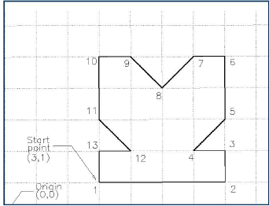
Absolute rectangular Coordinate
In order to draw the following shape using the absolute rectangular coordinate system, type the following points:
Points | Coordinate | Points | Coordinates
1 | 3,1 | 8 | #5,4
2 | #7,1 | 9 | #4,5
3 | #7,2 | 10 | #3,5
4 | #6,2 | 11 | #3,3
5 | #7,3 | 12 | #4,2
6 | #7,5 | 13 | #3,2
7 | #6,5 | 14 | #3,1

Slide 14
Relative rectangular Coordinate
In order to draw the following shape using the relative rectangular coordinate system, type the following points:
Points | Coordinate | Points | Coordinates
1 | 3,1 | 8 | @-1,-1
2 | @4,0 | 9 | @-1,1
3 | @0,1 | 10 | @-1,0
4 | @-1,0 | 11 | @0,-2
5 | @1,1 | 12 | @1,-1
6 | @0,2 | 13 | @-1,0
7 | @-1,0 | 14 | @0,-1

Slide 15
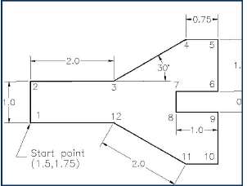
Polar coordinate
In the polar coordinate system, a point can be located by defining the distance from the initial point and the angle between the line joining the two points and the positive x-axis (by default).
Points | Coordinate | Points | Coordinates
1 | 1.5,1.75 | 8 | @0.5<-90
2 | @1<90 | 9 | @1<0
3 | @2<0 | 10 | @1.25<-90
4 | @2<30 | 11 | @0.75<180
5 | @0.75<0 | 12 | @2<150
6 | @1.25<-90 | 13 | @2<180
7 | @1<180

Slide 16
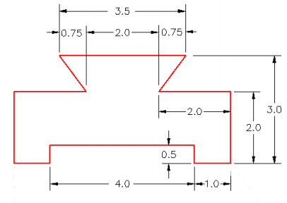
Class work 1
Draw the following object using the absolute rectangular , relative rectangular and polar coordinate systems. (Don’t draw the dimensions)

Slide 17
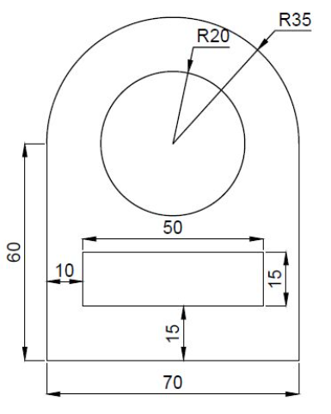
Class work 2
Draw the following object

Slide 18
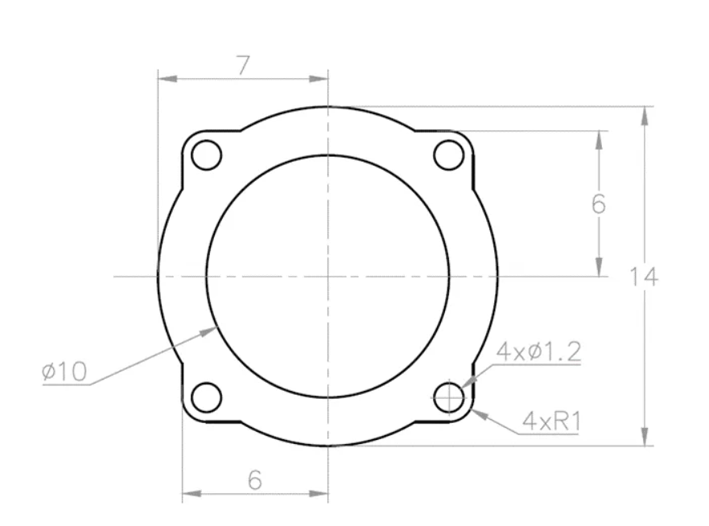
Class work 3
Draw the following object

Slide 19
ENGG105 AUTOCAD LAB

